Slide 1
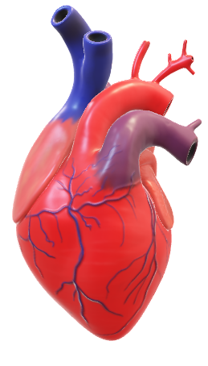
Heart Failure
Predicted by
Machine Learning
JAE HYUNG PARK

Slide 2
CONTENTS
01. Heart Failure Data
Contents
Data
Features Information
02. EDA & Preprocessing
EDA
Preprocessing
03. Models
Baseline Model
Models
Tree Models
Comparision Models
04. Interpreting Model

Slide 3
01
Heart Failure
Data

Slide 4
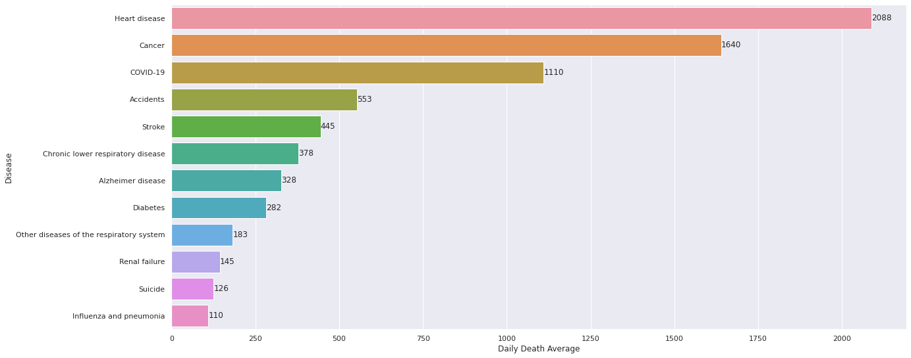
Heart Failure Data
01. Data
여러분은 최근 사망률이 가장 높은 질병이 어떤 질병이라고 알고 계시나요?
심장병(Cardiovascular Diseases, CVDs)
2 People die / 1hr
데아터 출처 : https://www.healthsystemtracker.org/brief/covid19-and-other-leading-causes-of-death-in-the-us/

Slide 5
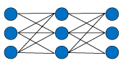
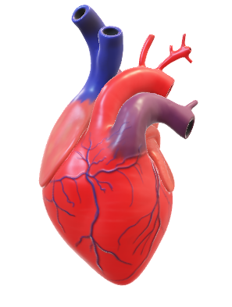

Heart Failure Data
01. Data
ML Overview
Heart Disease
Heart Disease Yes
Heart Disease No
Data Input
EDA
&
Preprocessing
Output
Modeling
데아터 출처 :https://www.kaggle.com/fedesoriano/heart-failure-prediction

Slide 6
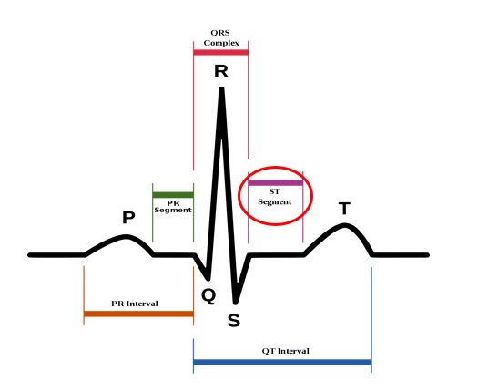
Heart Failure Data
02. Features Information
Features Information
· Age : 나이
· Sex : 성별 [F: Female, M: male]
· ChestPainType : 가슴통증 유형 [ASY: Asymptomatic, ATA: Atypical Angina, NAP: Non-Anginal Pain, TA: Typical Angina]
· RestingBP : 안정 혈압 [mm Hg]
· Cholesterol : 혈청 콜레스테롤 [mm/dl]
· FastingBS : 공복 혈당 [1: if FastingBS > 120 mg/dl, 0: otherwise]
· RestingECG : 안정 심전도
[LVH: showing probable or definite left ventricular hypertrophy by Estes' criteria,
Normal: Normal,
ST: having ST-T wave abnormality (T wave inversions and/or ST elevation or depression of > 0.05 mV)]
· MaxHR : 최대 심박동수 [Numeric value between 60 and 202]
· ExerciseAngina : 협심증 유발 운동 [N: No, Y: Yes]
· Oldpeak : 안정되기까지 운동으로 유발되는 ST depression
· ST Slope : 최대 운동 ST segment 기울기 [Down: downsloping, Flat: flat, Up: upsloping]
· HeartDisease : 심장병 진단 [1: heart disease, 0: Normal]

Slide 7
02
EDA & Preprocessing

Slide 8
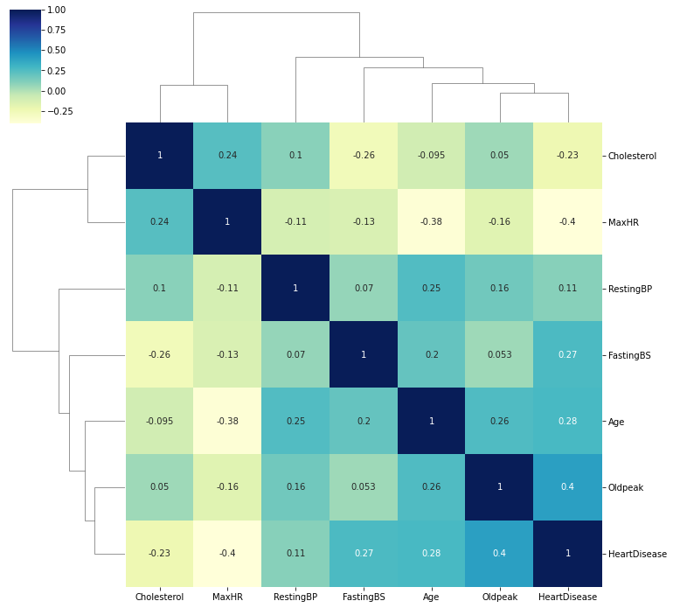
EDA & Preprocessing
01. EDA

Slide 9
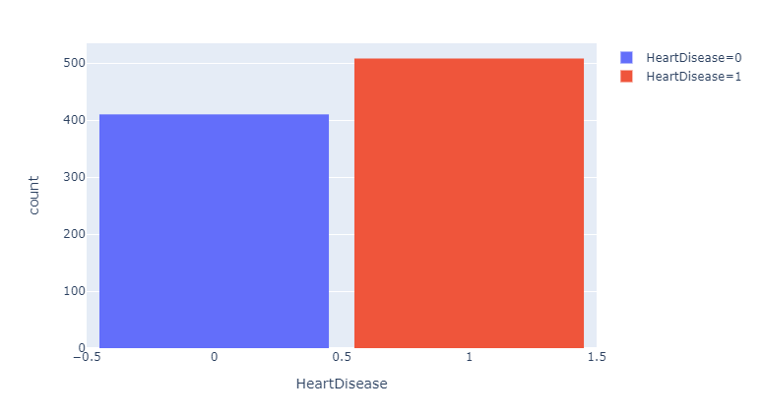
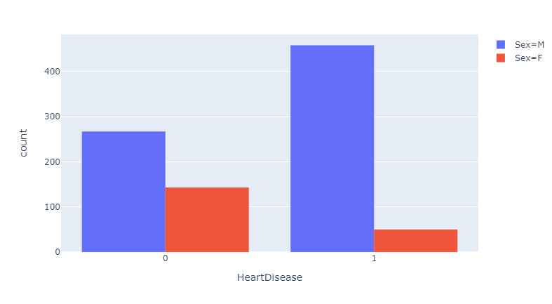
EDA & Preprocessing
01. EDA

Slide 10
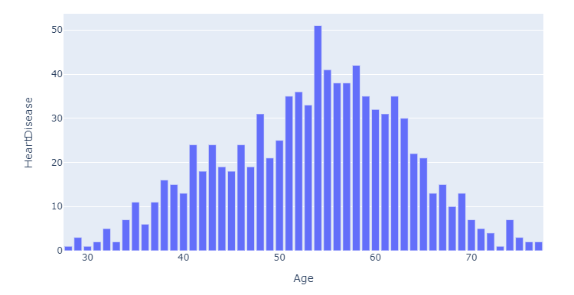
EDA & Preprocessing
01. EDA

Slide 11
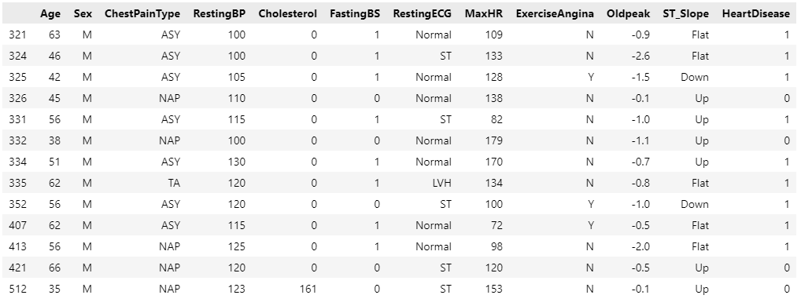
EDA & Preprocessing
02. Preprocessing
Oldpeak값이 음수가 될 수 없으므로 양수로 바꿔주었다.

Slide 12
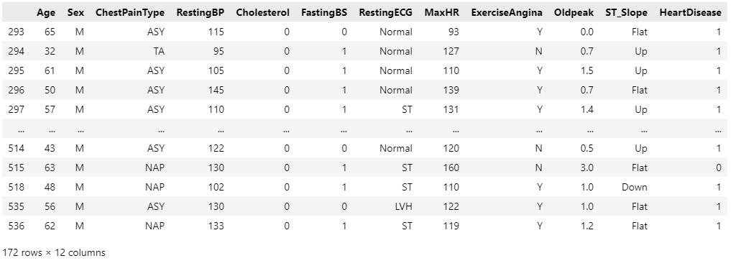
EDA & Preprocessing
02. Preprocessing
Cholesterol값이 0이 될 수 없으므로,
FastingBS과 관련이 높으므로 0인 값을 median값으로 처리해주었다.
RestingBP값이 0이 될 수 없으므로,
median값으로 처리해주었다.

Slide 13
03
Models

Slide 14
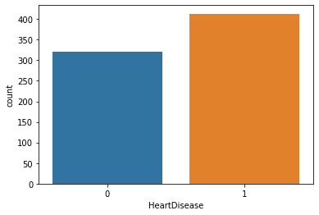
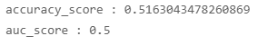
Models
01. Baseline Model
Baseline Model
최빈값 Model

Slide 15
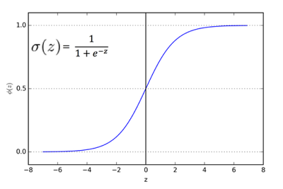
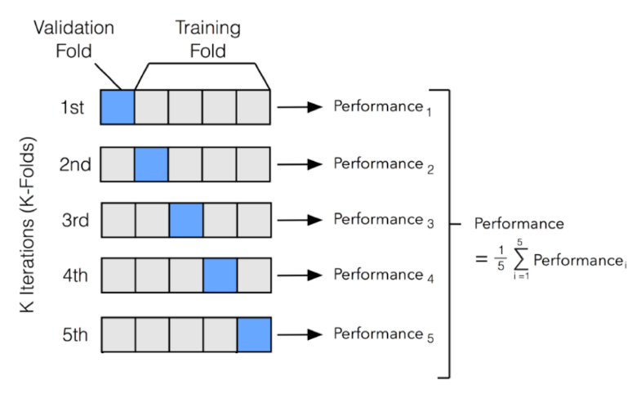
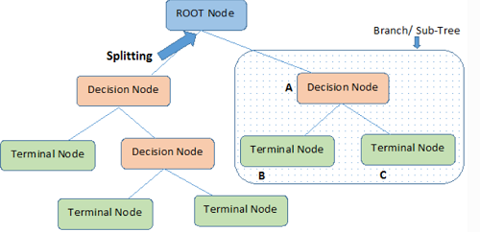

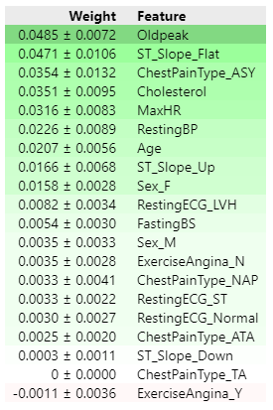

Models
02. Models
or
EDA & Preprocessed Data
Logistic Regression
Tree Model
GridSearchCV
Accuracy_Score
ROC_AUC_Score
Fit Model
평가지표
Permutation Importances

Slide 16
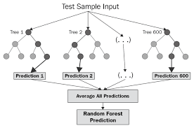
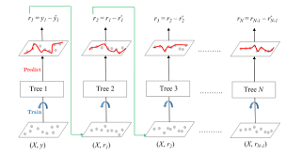
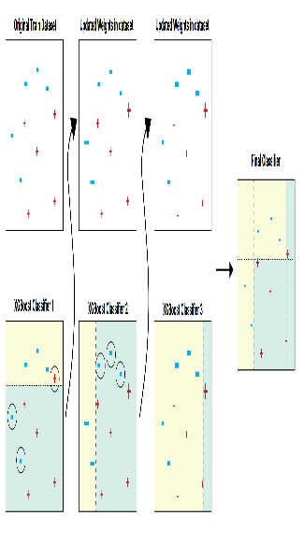
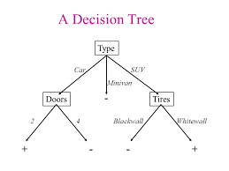
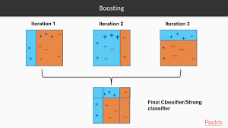
Models
03. Tree Model
Tree Model
Decision Tree
Random Forest
Adaboost
Gradient boosting
xgboost

Slide 17
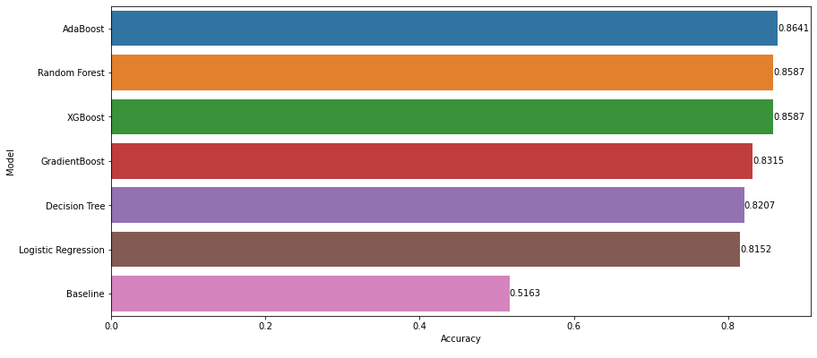
Models
04. Comparision_models

Slide 18
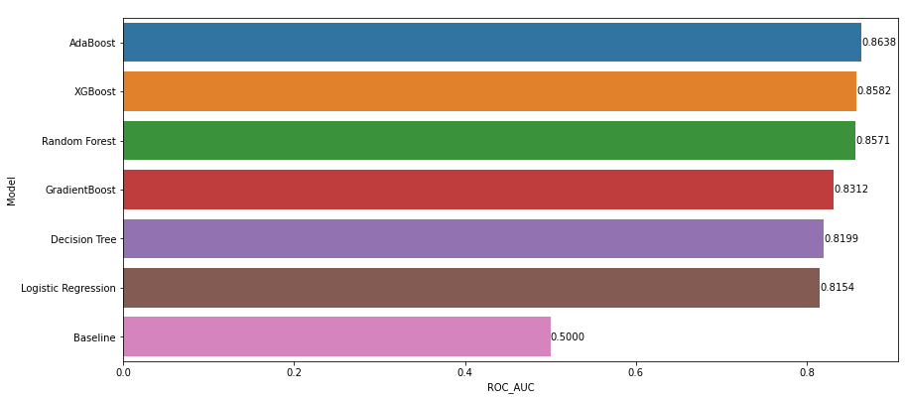
Models
04. Comparision_models

Slide 19
04
Interpreting Model

Slide 20
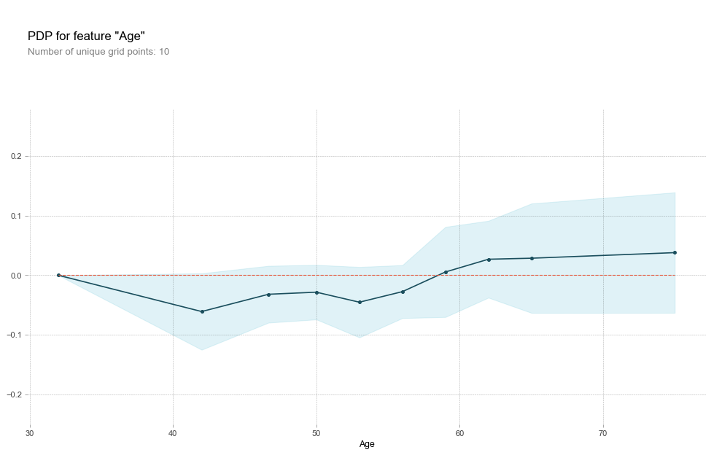
Interpreting Models
Xgboost Model

Slide 21
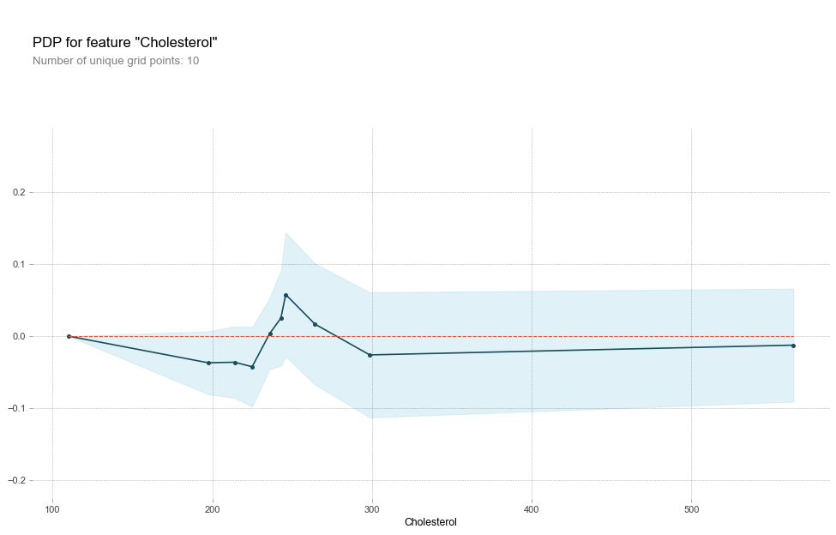
Interpreting Models
Xgboost Model

Slide 22
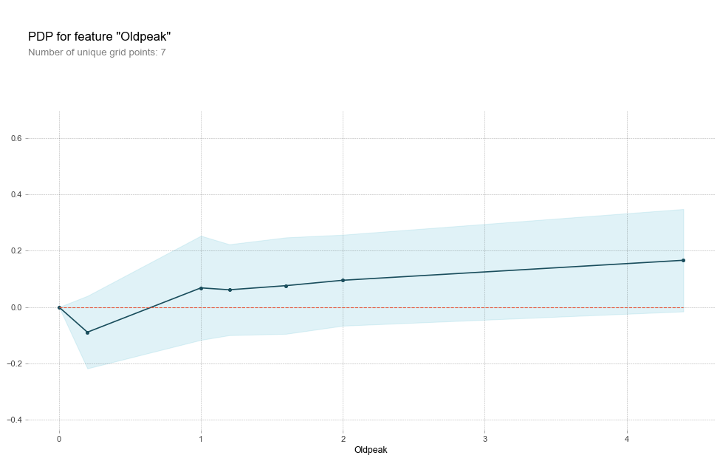
Interpreting Models
Xgboost Model

Slide 23
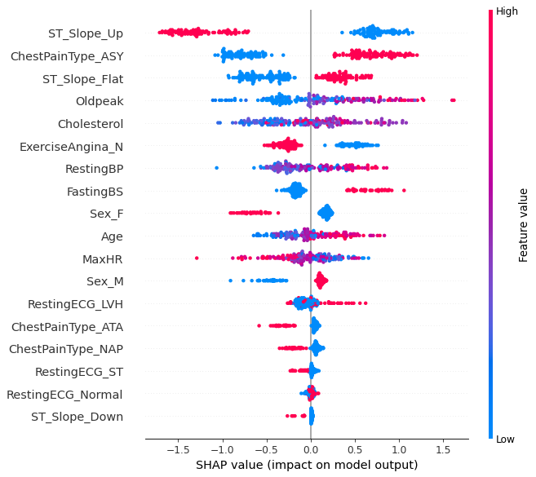
Interpreting Models
Xgboost Model
· Oldpeak : 안정되기까지 운동으로 유발되는 ST depression
· ChestPainType : 가슴통증 유형
[ASY: Asymptomatic, ATA: Atypical Angina, NAP: Non-Anginal Pain, TA: Typical Angina]
Oldpeak ↑, Cholesterol ↑, Age ↑, Male

Slide 24
THANK YOU

